Slide 1
Exploring Climate Migration – Mitigation & Adaptation Feedbacks with an Interactive Model
Dr Ben J.H. Matthews
ben@benmatthews.eu
Formerly at :
U.Edinb, UEA-ENV (uk), Qingdao-OU (zh), DTU/DEA (dk),
UNEP-GRIDA (no), U.Bern KUP (ch), UCLouvain (be), UFRJ-IVIG (br)
Participated UNFCCC COPs 2, 3, 6, 6b, 7, 9, 14, 15, 16
Research evolved:
Ocean-CO₂ fluxes => Global 2C/1.5C probabilistic scenarios,
=> Equitable development pathways => Scenario drivers
+ Aviation impacts, metrics, historical responsibility
cross-cutting long-term scenario issues …
Independent Climate Model Developer,
a.k.a …

Slide 2
one factor … climate scientists should apply calculations to lifestyle => concern aviation impact on climate =>
(Anecdote…) 1997 Climate Train to Kyoto...
Participate UNFCCC COP3 without aviation emissions
Conference Novosibirsk
Siberian south border climatic - steppe / forest
– fires … moving
Dynamic ecosystem models etc. – trees, birds adapt
But… people have passports, visas…
Compare e.g. Russia / Pakistan ... similar
  relative population, climate impacts, responsibility
migration obvious solution …?

Slide 3
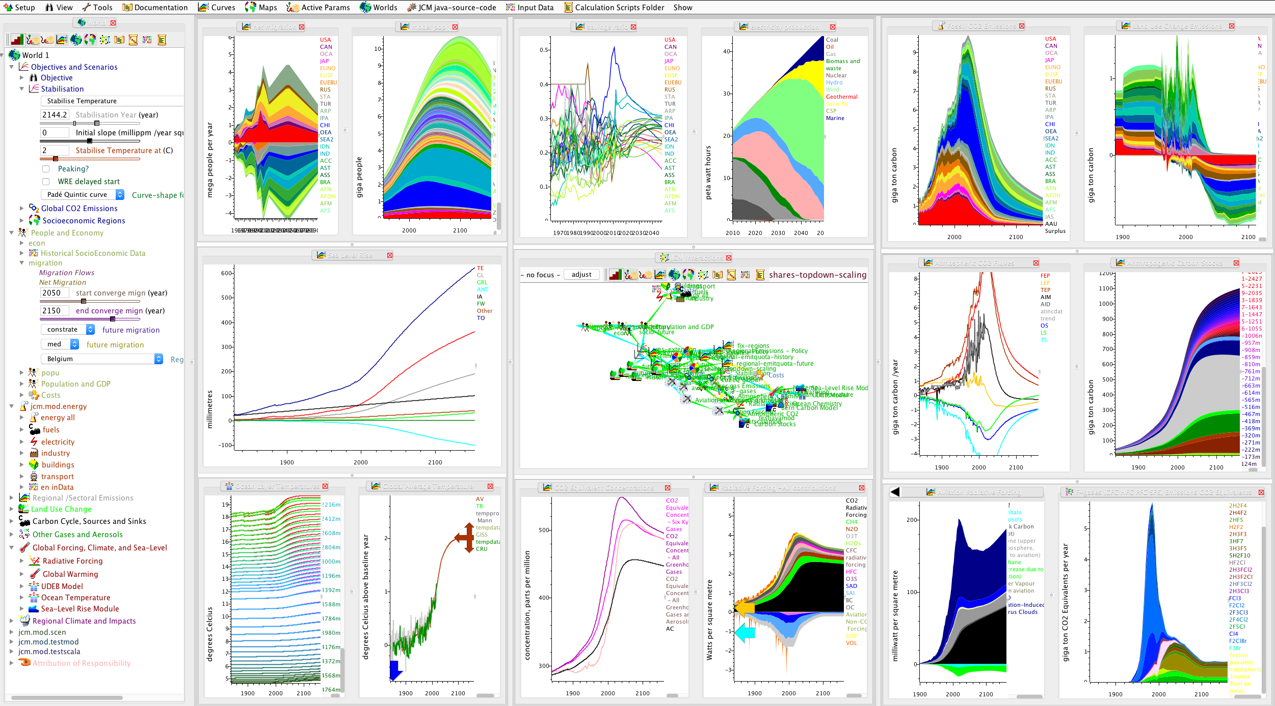
Java
Climate
Model
Since 2000…
Interactive Integrated Assessment (or System Dynamic?) Model
  (but ultimate IAM is global network human heads => interface)
Feedbacks easy as shared time-step loop
Instant graphical response, to 100s of parameters
– explore relative sensitivity policy options & sci-uncertainties.
=> also good for probabilistic analyses
First (2003) probabilistic analysis of <2C scenarios
+ recently <1.5C (equitable) regional pathways

Slide 4
JCM – chain: Population –> Economy –> Energy –> FosCO2, LandUseCh –> C-Cycle, Oth Gas –> RadFor – Climate-SeaLevel can run inverse targets eg <2C/1.5C

Slide 5
(IPCC) Climate Scenarios
RCPs : range of possible forcing => climate => impacts
SSPs – shared socioeconomic pathways
  span adaptation / mitigation challenge space
Parallel process => AR5,
  include feedbacks climate => scenario drivers?
But …
  * scenario development slow (SSPs => AR6),
  * divided between models,
  * paper reports poor for explore feedbacks
  => Develop drivers modules JCM
Migration in SSPs ?
  Simply assume constant rate (emigrate) to 2050, decline =>0 thereafter
  (UN DESA WPP similar approach)
  * Med (SSP1 - sust, 2-mid, 4-uneq),
  * Low (SSP3 -frag) =>0 (in 15y )
  * High (SSP5-glomar) => x2 (in 15y)
Should be feedbacks from climate, economy, culture, …
  (in IAMs migration = input, climate = output, no loop)
  => Explore migration (choices) => scenarios in JCM ?

Slide 6
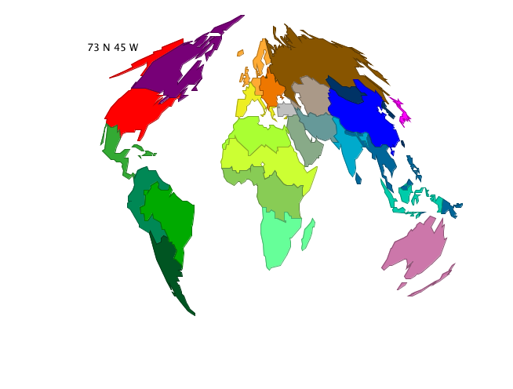
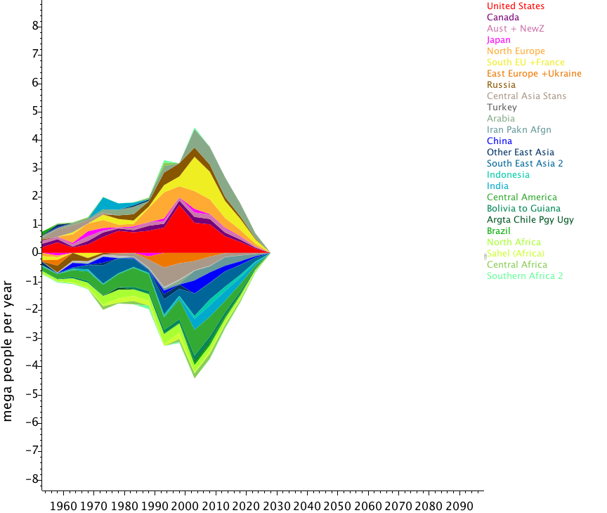
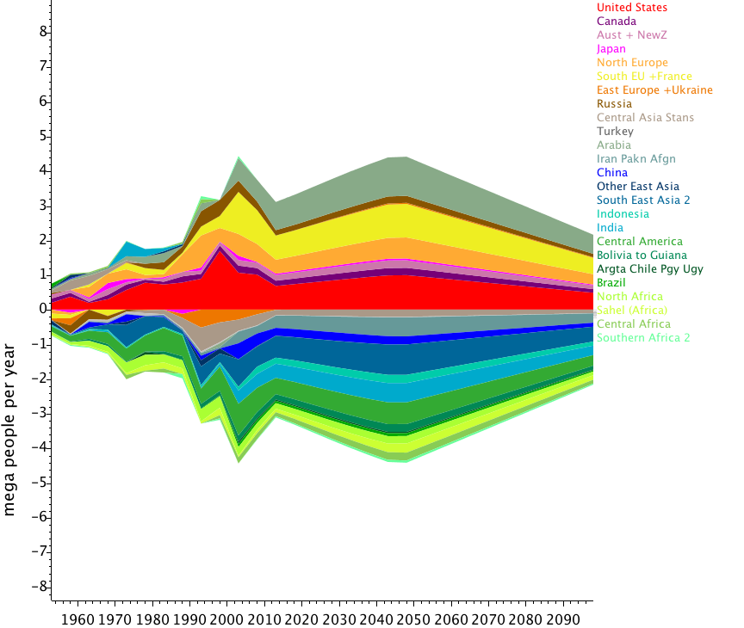
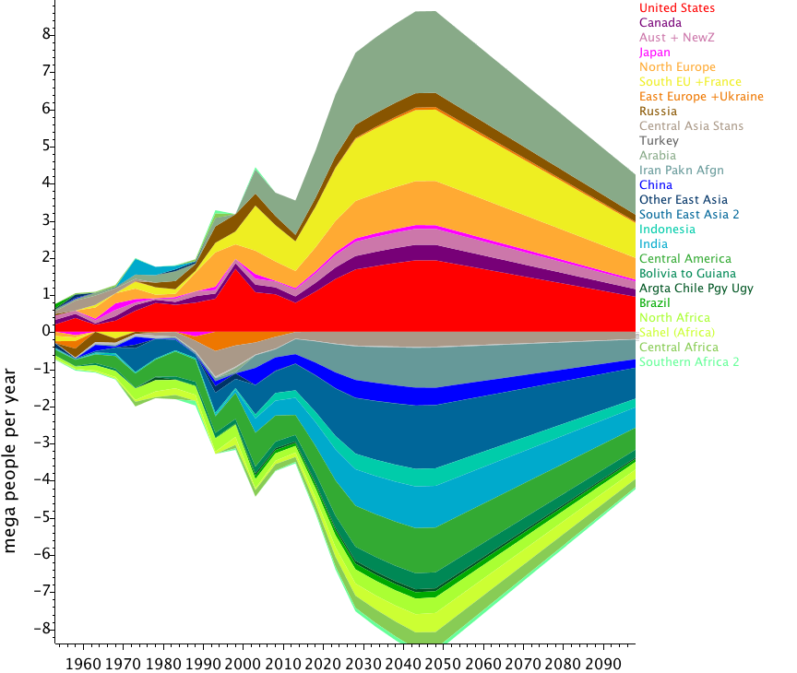
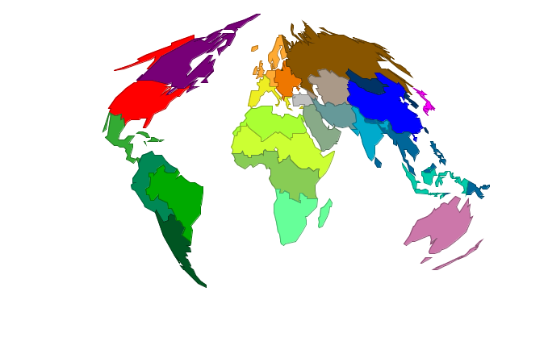
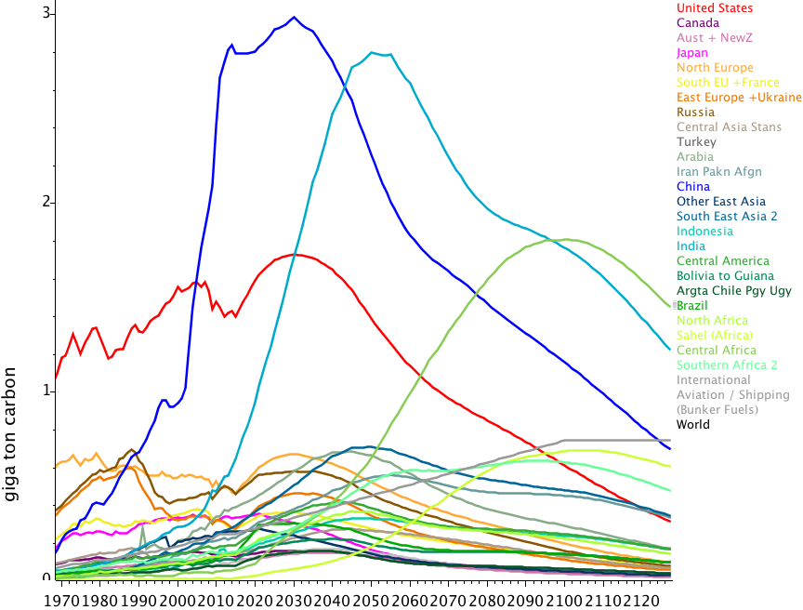
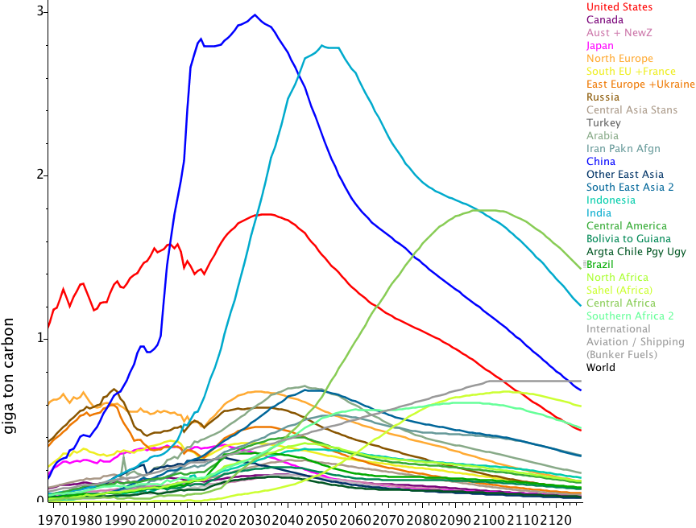
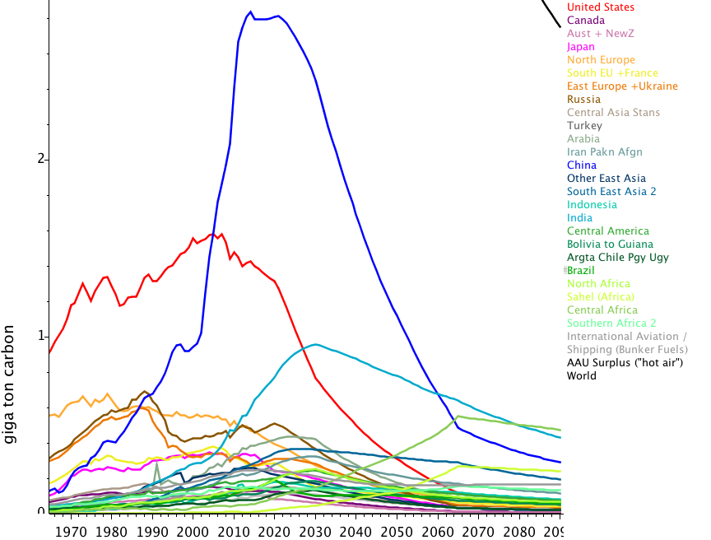
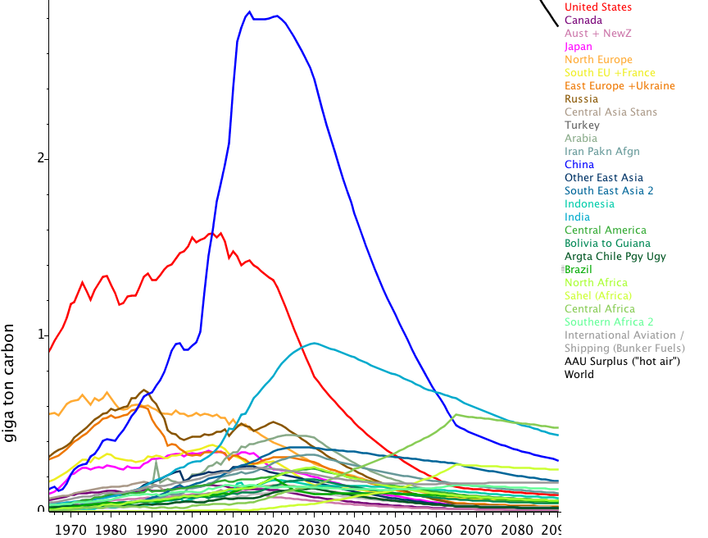
JCM - try variants future migration => global effects CO2... build on Abel et al. Mign Flows – adapt to Low, Med, High similar SSPs
Migration changes average fertility, mortality, lifestyle etc…
Higher Migration
  => lower population (long-term)
  => Lower global GDP (due popm)
    (but raises locally – and med > high > low)
  => Raises earlier emissions in baseline scenario
  (due higher emit/capita lifestyle of destn)
  => Lowers later emissions (due popn)
In a 2C top-down sharing scenario (multi-criteria convergence) migration makes more difference to developed countries esp USA
Not yet tested with much higher climate-driven migration
Global effects migration => minor
Admit not exciting result – First quick calc show poss explore with exising model - many factors missing)
Low (left) and High Mign,
Baseline (top) 2C scenario (below)

Slide 7
Effect (=> emissions mitign) maybe much greater…
Depends where people go to …
Construction is a large element of economy / emissions
  especially in China – up to 50% economy
Concrete – about 4% of CO2,
  but steel etc.– more ? (no tech alternatives as for electricity)
Infrastructure necessary for development
  but not empty speculative apartments… employment feedback
Is this scale of urbanisation really good? (scenarios assume)
In some places housing supply > demand, but migration
Developing Energy model in JCM
But hard to separate data eg Industry for

Slide 8
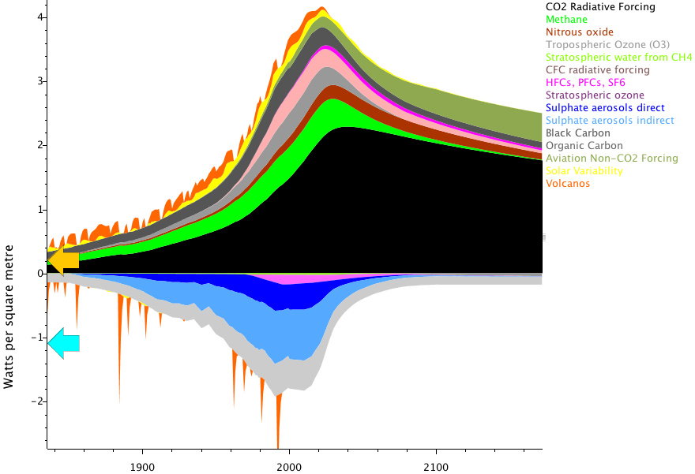
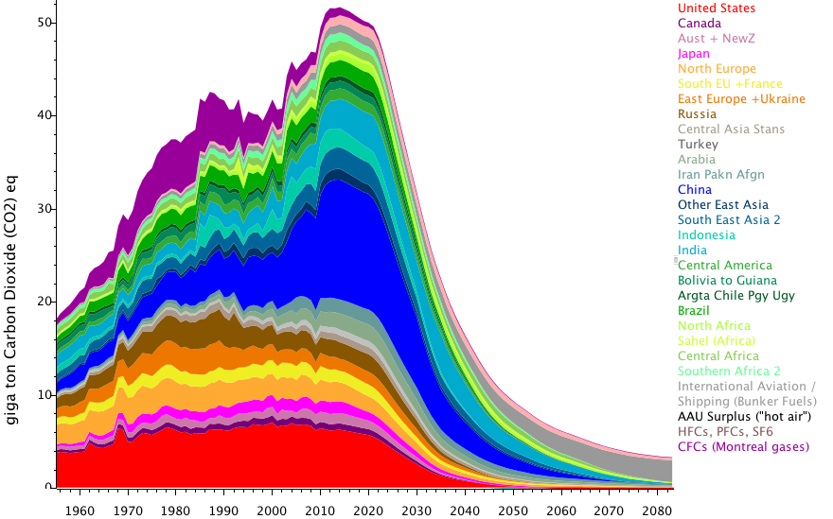
Where people move .. Influences international transport - Aviation
Aviation most rapidly growing source of CO2 emissions -and least controlled
Aviation-induced Cirrus-clouds and NOx also significant
(short-term regional warming )
Although initial migration insignificant share of travel, visiting friends, family later can be
  (Legacy of european empires – eg flights UK-Australia … )
Example: a <1.75C stabilisation scenario variant with BAU aviation
- aviation forcing => less space for CO2,
- by 2070 aviation uses up all the available CO2 budget
  (JCM for 1.5C Oxford conf)

Slide 9
Summary Migration influence on *Mitigation*
Where people choose to settle influences energy demand:
  housing supply vs demand, construction requires energy
  heating/cooling need
  regional supply of food, water, renewable energy
  potential air-travel to former communities
  local transport services
  local lifestyle (modest/luxury consumption)
  factors influencing future demographics (fertility)
Migration to good locations could be opportunity for both mitigation and adaption, but ….

Slide 10
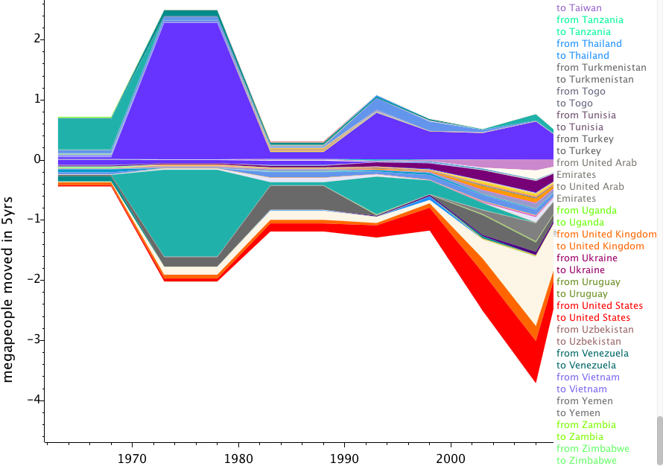
Where do people really go?
Net Migration Trends
Large recent international flux from South-Asia to Arabian Gulf
  (Dubai etc. – low rights - temporary? )
  (<= example shows net migration India)
Largest flux is probably Chinese internal migrant laborers
  => Pearl River Delta, Shanghai, Tianjin…
Also in Africa – Lagos, Nile Delta…
Warm megacities close to sea level

Slide 11
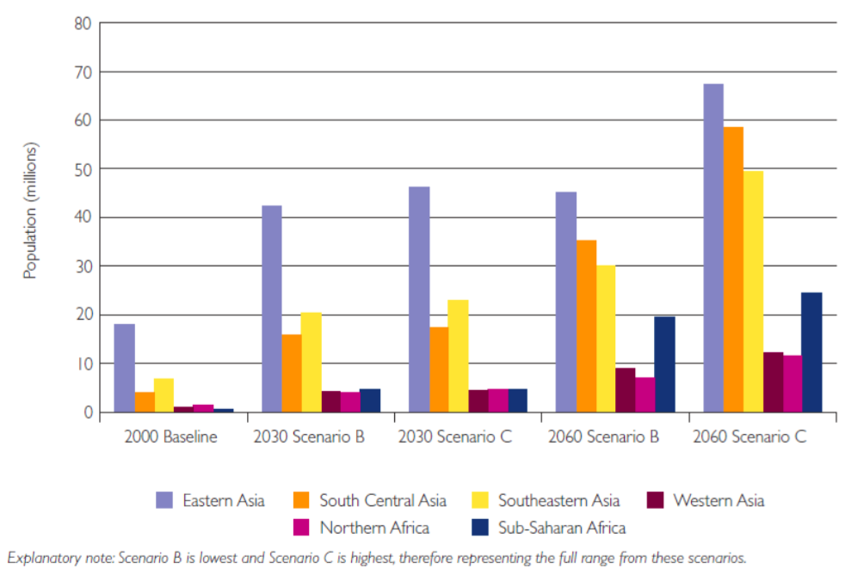
The opposite of climate Adaptation!
Expanding cities in poor locations - coastal zones
  ex-european colonial ports wrong place for megacities – accidental, no strategy …
Deltas were also highly-productive agricultural land …
Gulf cities dependent on air-conditioning
  Indoor ski-slopes in the desert... – life quality?
Lost opportunity … people will have to move again...
  (=> more construction emissions ...)
=> Plan to incorporate such detail in JCM
Population Growth in Urban Coastal
Flood Zones - Vafeidis et al –(Foresight)

Slide 12
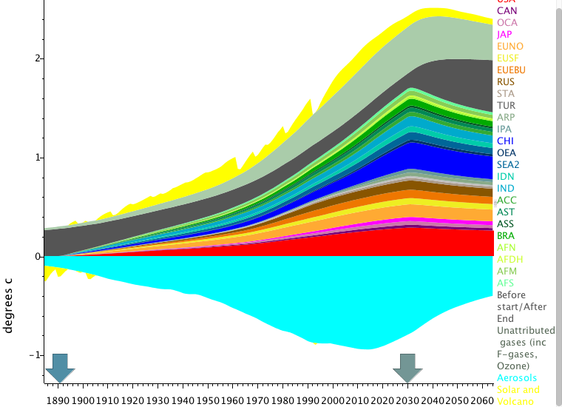
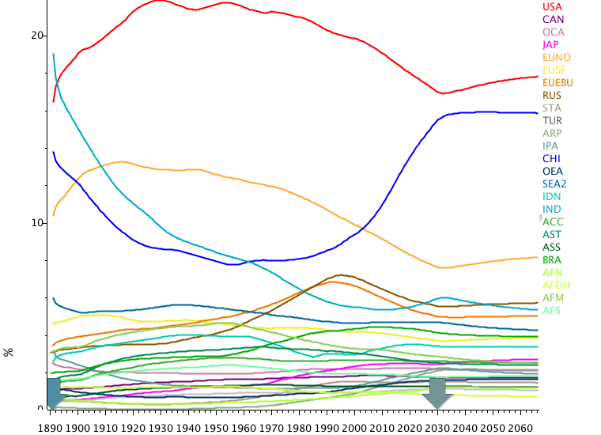
Historical Responsibility (also to receive migrants ?)
Migration to cooler high latitude countries makes sense climatically, but how convince receiving community that migrants have right to come?
Quantifying “Historical Responsibility” for climate change may be relevant
Much work on this topic via ACCC/MATCH with JCM
But get it right
  - cumulative emissions misleading (nonlinear system).
  Transfer of people and technology is relevant.
  Don’t divide past emissions by present population!
Brazil integrates 19th century emissions – points to responsibility of Europe – but ancestors of current Brazilians lived in Europe at that time!
[Also Consider development legacy – infrastructure etc., of past emissions with older technology. Liege evident example! ]
Also relevant in the context of Loss + Damage funding
Example historical contributions to current warming 1890-2030 after Paris NDCs – USA still ahead of China (just)

Slide 13
“Choose – Climate” tool?
Where move next… Many factors (inc climate ...) Quantify mix?
20 yrs ago made website “chooseclimate”
Global “referendum” re interpreting UNFCCC Article 2
    Maybe not so wise!
But migration is another way for people to choose climate
  Develop a tool for public, focus on including future climate in relocation choice?
Migration can be an opportunity for climate mitign/adaptn
– if choose good destination

Slide 14
Next steps
More regional detail in JCM
  - Especially for internal migration
  eg between Chinese / Indian provinces
    - but harder to get data
Develop adaptation end
- regional climate impacts within JCM
Quantify effects on construction, travel etc…
JCM was an interactive tool – open, easy to access on web.
  No longer so, due to java changes
  Working on fix interface – adapting to Scala language
  Other applications for such a tool ?
So – please watch this space
jcm.climatemodel.info (but wait a few weeks…)
ben@bematthews.eu
Suggestions?

